Slide 1


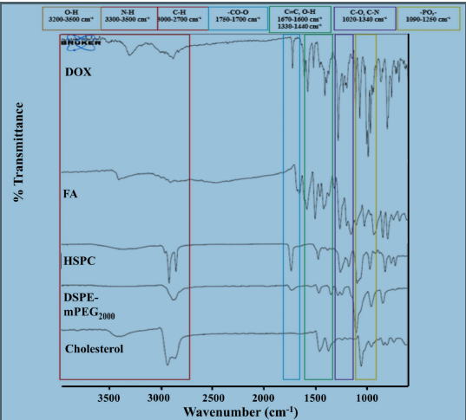
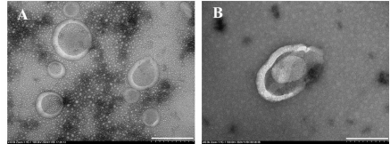
SANTHIRAM COLLEGE OF PHARMACY
(AUTONOMOUS)
Indo-Caribbean International Conference on
Innovations in Drug Design, Development, Analysis & Patient Care - A Synergizing Science & Practice with Association of Pharmacy Professionals
TITLE OF PRESENTATION:
AUTHORS:
DEPT.
COLLEGE NAME
Conf. Code: 001
ABSTRACT:
DISCUSSION:
INTRODUCTION:
CONCLUSION:
RESULTS:
REFERENCE:
MATERIALS:
METHOD:
ACKNOWLEDGEMENT:
Presented at the Indo- Caribbean International Conference held at SRCP, on 7th March 2025
Add Image/Videos

